Slide 1
A Seminar on Integrating Blockchain for Advanced Supply Chain Solutions
Team Details
Rathlavath Rajesh(20EG105401)
Gajjela Stevenson(20EG105412)
Neelagiri Chandradeep(20EG105429)
Project Supervisor
Pallam Ravi
Assistant Professor

Slide 2
Introduction
BLOCK CHAIN:
Blockchain is a type of Distributed Ledger Technology (DLT) where data is stored in blocks that are chained together. Each block contains a number of transactions, and once a block is completed, it becomes part of the timeline, or the "chain".
Each transaction on the blockchain is encrypted and linked to the previous transaction. This alongside the decentralization aspect, ensures a high level of security and transparency.
Supply Chain Management:
Supply chain management (SCM) is a comprehensive and strategic approach that encompasses the entire process of designing, planning, executing, controlling, and monitoring the supply chain activities. At its core, SCM involves the coordination and integration of various functions and processes, from the procurement of raw materials to the delivery of finished products to end customers. The primary objective of supply chain management is to optimize efficiency, minimize costs, and enhance overall performance throughout the supply chain network.
For effective supply chain management, several key elements are essential. First and foremost, a robust information system is needed to facilitate communication and collaboration among different entities within the supply chain. Real-time data sharing allows for quick decision-making, inventory management, and demand forecasting. Additionally, a well-defined and efficient logistics infrastructure, including transportation and warehousing, is crucial for the smooth flow of goods.

Slide 3
Applications:
Supply chain management finds applications across diverse industries, including manufacturing, retail, healthcare, and more. In manufacturing, SCM helps in streamlining production processes, managing inventory levels, and ensuring timely delivery of products. In the retail sector, SCM aids in inventory optimization, reducing stockouts, and improving customer satisfaction through timely order fulfillment. In healthcare, SCM is vital for managing the procurement and distribution of medical supplies and ensuring the availability of essential items in healthcare facilities.
Benefits:
Security
Transparency
Immutability
Accessibility
Reduced Costs and Increased Efficiency

Slide 4
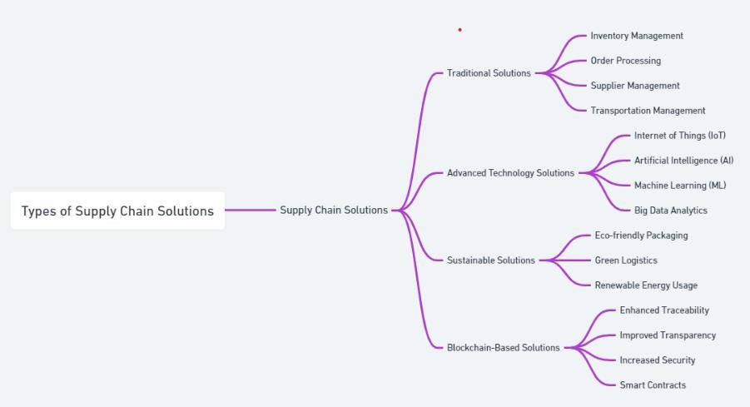
Concept Tree

Slide 5
Literature
 | Author(s) | Strategies | Advantages | Disadvantages
1 | Prince Waqas Khan and Yung-Cheol Byun | This includes the use of smart contracts for automated transactions and electronic wallets for payments. | Enhanced trust and transparency in EV charging and payment processes. | Integration challenges with existing legacy systems.
2. | Rateb Jabbar, Mohamed Kharbeche | Implementation of a blockchain-based system for secure, decentralized communication in the Internet of Vehicles. | Decentralization of the communication system. | Complexity in implementing and integrating blockchain technology.
3. | Bing Jia, Tao Zhou, Wuyungerile Li | The paper proposes a blockchain-based incentive mechanism for crowd sensing networks that focuses on protecting location privacy. | Improved user participation due to incentives for sharing high-quality, secure data. | Potential scalability and efficiency challenges due to blockchain's inherent characteristics.

Slide 6
 | Author(s) | Method | Advantages | Disadvantages
4. | Alejandro Baldominos, Yago Saez | Proof-of-UsefulWork for blockchain-based distributed deep learning | Productive use of computational work, integration of AI and blockchain | The integration of deep learning model training into blockchain mining
5. | Ittay Eyal, Adem Efe Gencer | The strategy involves dividing the blockchain operation into two distinct components: leader election and transaction serialization. | Significantly higher throughput and lower latency compared to traditional Bitcoin. | Potential challenges in achieving widespread adoption due to its departure from traditional blockchain models.

Slide 7
Comparison of Existing Strategies for Problem solve
1 | Blockchain-based Supply Chain Management | - Enhanced security and immutable data records - Improved transparency across the network - Decentralized architecture fosters trust - Streamlines information sharing among stakeholders | - High initial setup cost- Technological barrier for some users - Dependence on power and internet infrastructure
2 | Traditional Supply Chain Management | - Familiar and established systems - No need for advanced technology integration - Easier for stakeholders with limited tech capabilities | - Limited transparency and traceability - Higher risk of errors and fraud - Inefficient information sharing leading to delays
3 | Centralized Digital Supply Chain Systems | - Improved efficiency over traditional systems - Easier data management and accessibility - Can incorporate some level of security and tracking | - Risk of centralized data breaches - High dependency on the central system's reliability - Possible resistance from stakeholders used to traditional methods
4 | Hybrid Supply Chain Models | - Combines the best of traditional and digital methods - Flexibility to adapt to different stakeholder needs - Can gradually introduce technology improvements | - Complexity in managing both digital and traditional elements - May not fully leverage the advantages of blockchain - Potential confusion among stakeholders during transition

Slide 8
Problem Statement
Lack of transparency and trust in traditional supply chain processes hampers efficiency
Current supply chain mechanisms face critical challenges such as limited transparency, ineffective information sharing, and suboptimal coordination among stakeholders. This project proposes a blockchain-based solution to revolutionize supply chain management. By leveraging blockchain's inherent qualities like immutable data records, enhanced security, and decentralized architecture, the proposed system aims to foster trust, improve transparency, and streamline information sharing across the supply chain network. This approach not only aims to optimize operational efficiency but also enhances the reliability and integrity of supply chain processes.

Slide 9
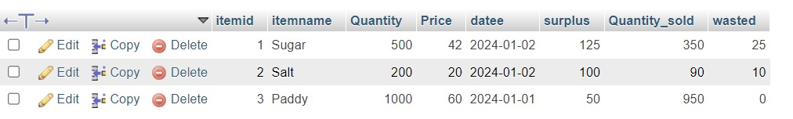
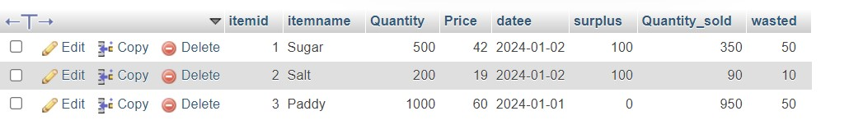
Problem Illustration
Before Tampering:
After Tampering:

Slide 10
Proposed Method
Proposed Method: blockchain-based supply chain system:-
Step-1: Research and Install Necessary Technologies
Step-2: Design the Network Architecture
Step-3: Create Smart Contracts
Step-4: Node Setup
Step-5: Testing
Step-6: Deploy the solution to the production environment
Step-7: Monitoring and maintenance

Slide 11
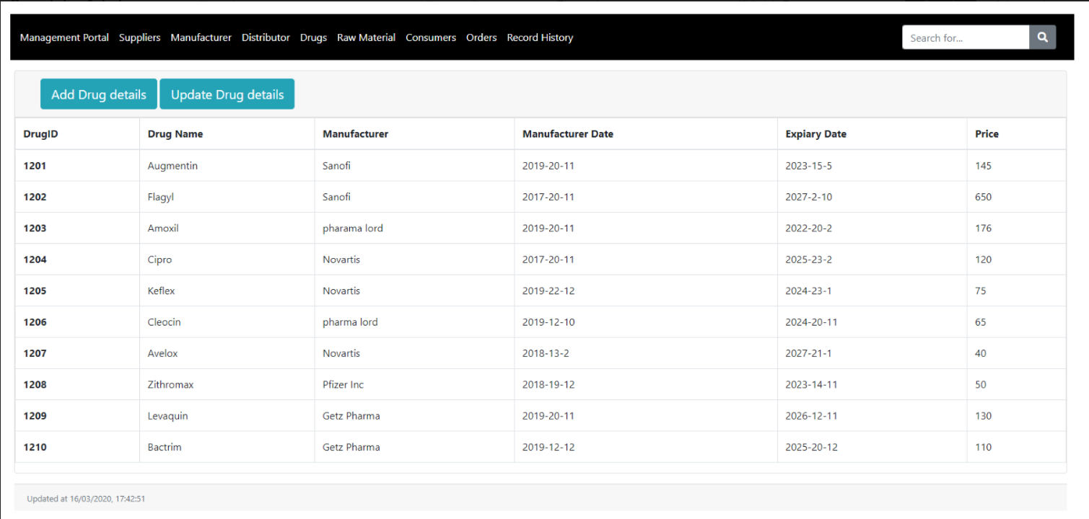
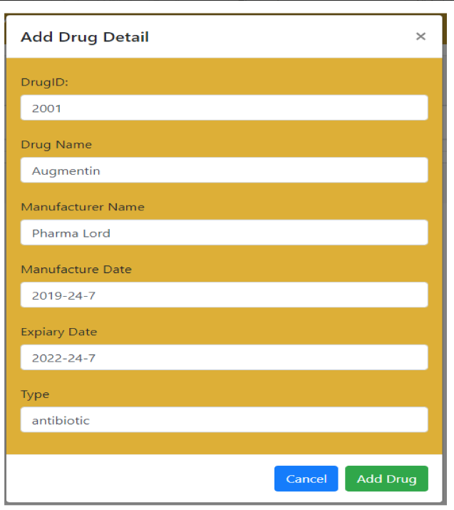
Proposed Method Illustration

Slide 12
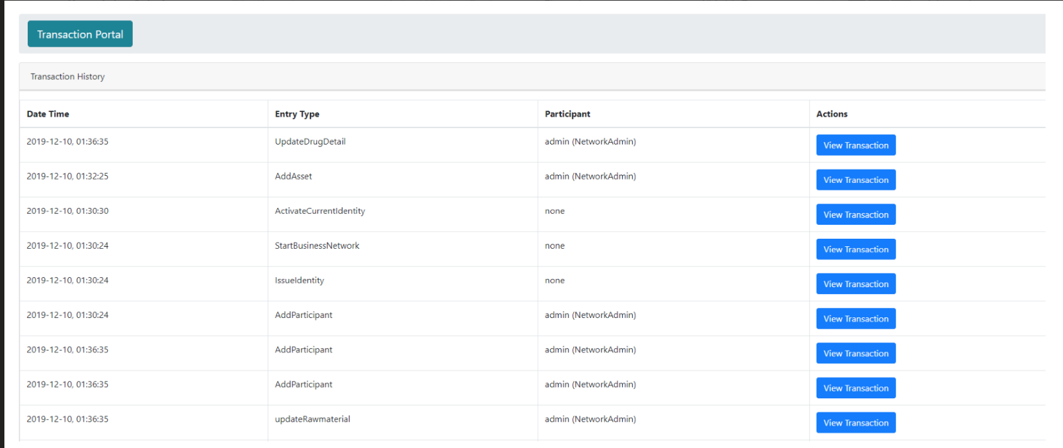
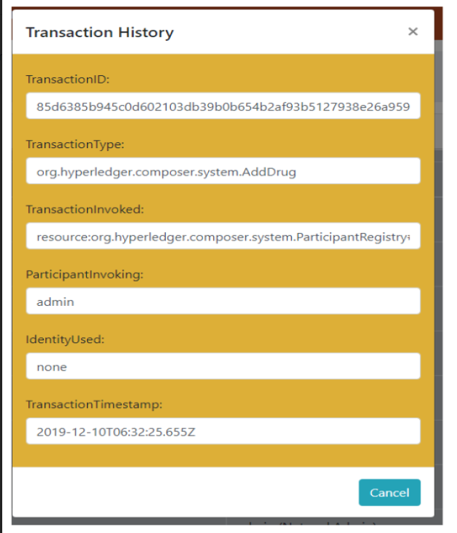
Proposed Method Illustration

Slide 13
Parameter
1.) Transaction Throughput:
> TPS = Number of Transactions
Time
Latency :
> Formula: Latency= Time taken for a transaction confirmation
Scalability:
>Formula: Scalability = Number of Transactions or Scalability =Number of Participants
Time Resources
4) Smart Contract Execution Time:
>Formula: Smart Contract Execution Time =Time taken for a smart contract to execute

Slide 14
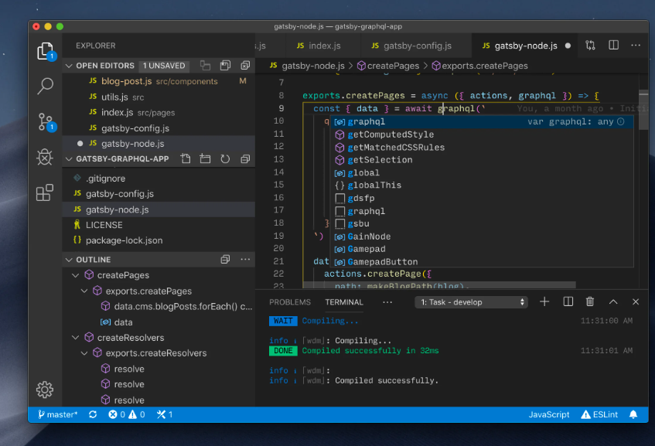
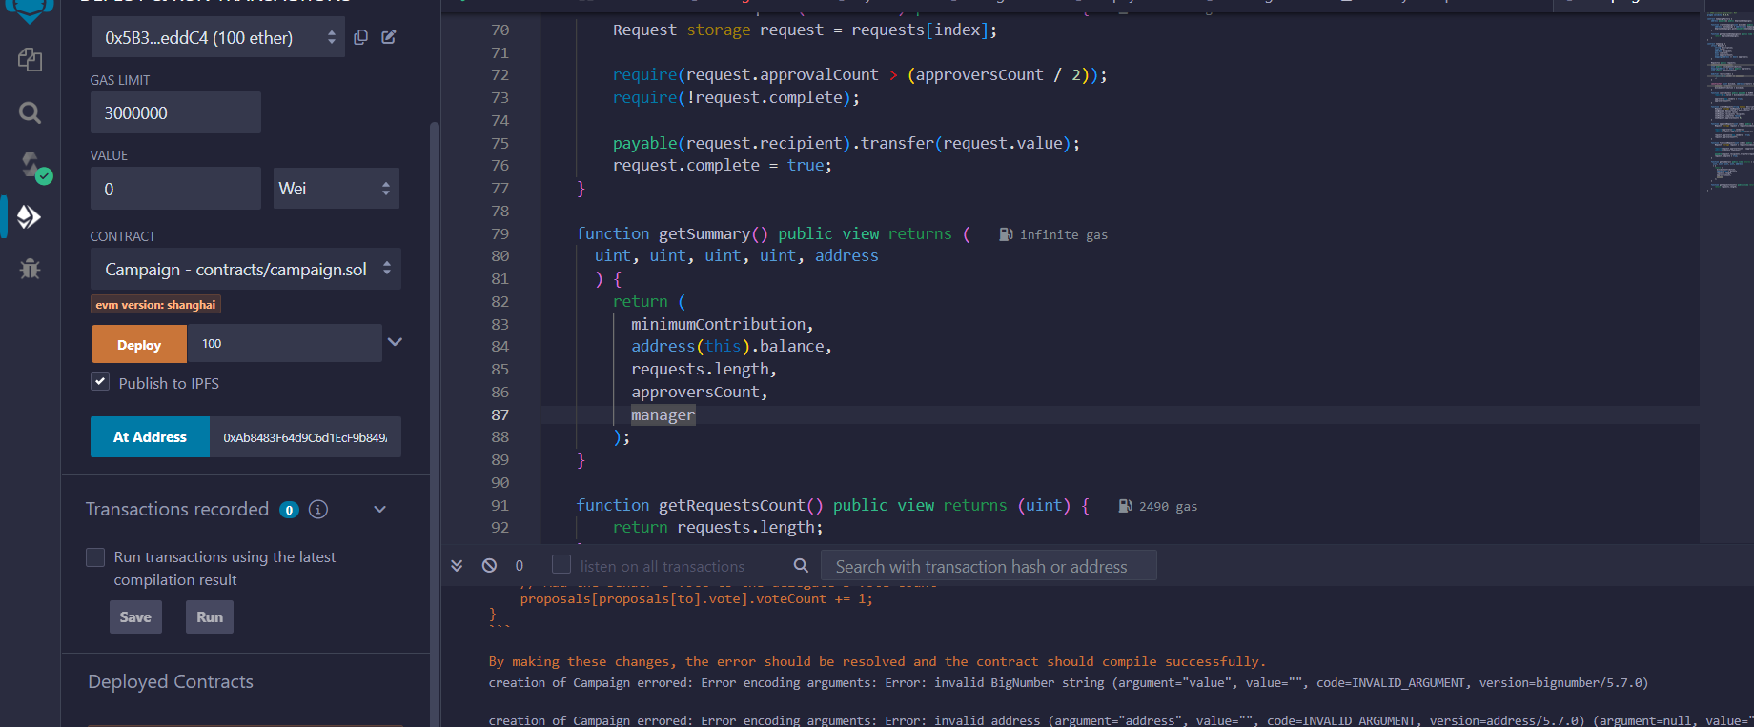
Experiment Environment
Visual Studio Code
Remix IDE

Slide 15
Project status
S.No | Functionality | Status (Completed /in-progress/Not started)
1. | User registration | Completed
2. | Insertion of supply chain system values | In-progress
3. | Testing | Not started
4. | Deployment | Not started

Slide 16
References
References
[1] Khan, P.W.; Byun, Y.-C. “Blockchain Based Peer To Peer Energy Trading And Charging Payment System For Electric Vehicles.” Sustainability 2021, 13, 7962. https:// doi.org/10.3390/su131479
[2] Z. Li, J. Kang, R. Yu, D. Ye, Q. Deng, and Y. Zhang, “Consortium blockchain for secure energy trading in industrial Internet of Things,” IEEE Trans. Ind. Informat., vol. 14, no. 8, pp. 3690–3700, Aug. 2018
[3] T.Jiang,H. Fang, and H. Wang, “Blockchain-based Internet of vehicles: Distributed network architecture and performance analysis,” IEEE Internet Things J., vol. 6, no. 3, pp. 4640–4649, Jun. 2019.
[4] A.Baldominos and Y. Saez, “Coin.AI: A proof-of-useful-work scheme for blockchain-based distributed deep learning,” 2019. [Online]. Available: arXiv:1903.09800.
[5] I. Eyal, A.-E. Gencer, E.-G. Sirer, and R. van Renesse, “Bitcoin-NG: A scalable blockchain protocol,” in Proc. 13th USENIX Symp. Netw. Syst. Design Implementation, 2016, pp. 45–59.
[6] AHMED AFIF MONRA ,” A Survey of Blockchain From the Perspectives of Applications, Challenges, and Opportunities” July 7, 2019 Available: https://ieeexplore.ieee.org/document/8805074

Slide 17
Thank you

Slide 18
Project seminar–I Evaluation
S.No | Rubrics | Marks
1 | Concept Introduction | 4
2 | Literature and Parameter | 5
3 | Problem and Problem Illustration | 8
4 | Proposed Method and Illustration | 8
Total |  | 25

